Slide 1
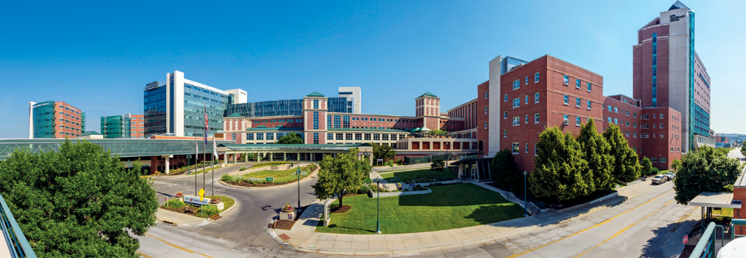
About Us
Nebraska Medicine
$2.3 billion academic health system
9,600 employees and more than 1,400 affiliated physicians
Primary clinical partner of University of Nebraska Medical Center
Two hospitals, anchored by tertiary/quaternary academic medical center
More than 70 specialty and primary care clinics, with 50 specialties and subspecialties
809 licensed inpatient beds in Omaha and Bellevue
Nebraska Medical Center: 718 licensed beds
Bellevue Medical Center: 91 licensed beds
In 2023:
30,761 discharges
908,000 in-person primary and specialty patient visits
102,000 telehealth visits
94,100 emergency department visits
Planning underway for Project Health, including a state-of the art academic medical center
Notes:
*updated in Jan. 2024
*Discharges does not include outpatent observation as it did in years past. This is to sync data with numbers Finance reports.

Slide 2
About Us
Services and Awards:
International reputation in oncology, solid organ and bone marrow transplant and biocontainment
Regional leader in cardiovascular and neurosciences
American College of Surgeons (ACS) verified Level 1 trauma center admitting both pediatric and adult patients 24/7
Named Best Hospital in Nebraska for 12 consecutive years by U.S. News & World Report
Nebraska Medical Center named as one of the 100 Best Hospitals in America for seven consecutive years by Becker’s Hospital Review
Nebraska Medical Center named one of the nation's best hospitals by Newsweek for the past three years
Nebraska Medical Center named one of the nation's "Top Maternity Hospitals" by Newsweek for two straight years
National Consumer Loyalty Award winner from NRC Health for 14 consecutive years
Named Forbes Best-in-State Employer for five consecutive years
Magnet Recognition from the American Nurses Credentialing Center since 2008
Both medical centers received Patient Safety Excellence Award from Healthgrades in 2022
Nebraska’s Safest Companies award from The National Safety Council for 15 years running
HIMMS Analytics Stage 7 designation for inpatient and outpatient primary care, which is the highest certification for electronic medical record adoption
Notes:
Joe and Paul updated Jan 2024
*US News, Newsweek and Forbes have been updated for CY23
US News best hospital in Nebraska- since 2011
Forbes Best in State – since 2019
Newsweek – since 2021
Patient safety excellence awards from Healthgrades 2022
2022 was 15 years for National Safety Council
No 2021 or 2022 Becker’s 100 great hospital awards held, was last awarded in 2019
2021 was 13 years for NRC Consumer Loyalty award (formerly called consumer choice award)

Slide 3
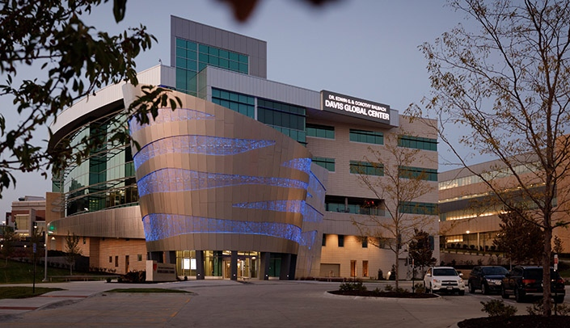
Our Partnership with the
University of Nebraska Medical Center
Six colleges and two institutes
4,555 students and 6,304 employees
$970 million operating budget and $250.5 million in sponsored awards, including $173.4 million in research grants
Together, UNMC and Nebraska Medicine have an annual impact of $5.9 billion
Nearly half of Nebraska’s physicians, dental professionals, pharmacists, bachelor-prepared nurses and allied health professionals graduated from UNMC
The Dr. Edwin G. & Dorothy Balbach Davis Global Center opened in 2020 and houses the National Quarantine Unit and the iEXCEL clinical simulation program
2023 U.S. News & World Report Rankings
Best Medical Schools: Primary Care
Best Medical Schools: Research
Best Nursing Schools: Doctor of Nursing Practice
Biological Sciences
Biostatistics
Pharmacy
Physical Therapy
Physician Assistant
Public Health
The Dr. Edwin G. & Dorothy Balbach Davis Global Center
Notes:
Updated Jan 2024 with input from UNMC.edu, strategic comms, and James Gieger

Slide 4
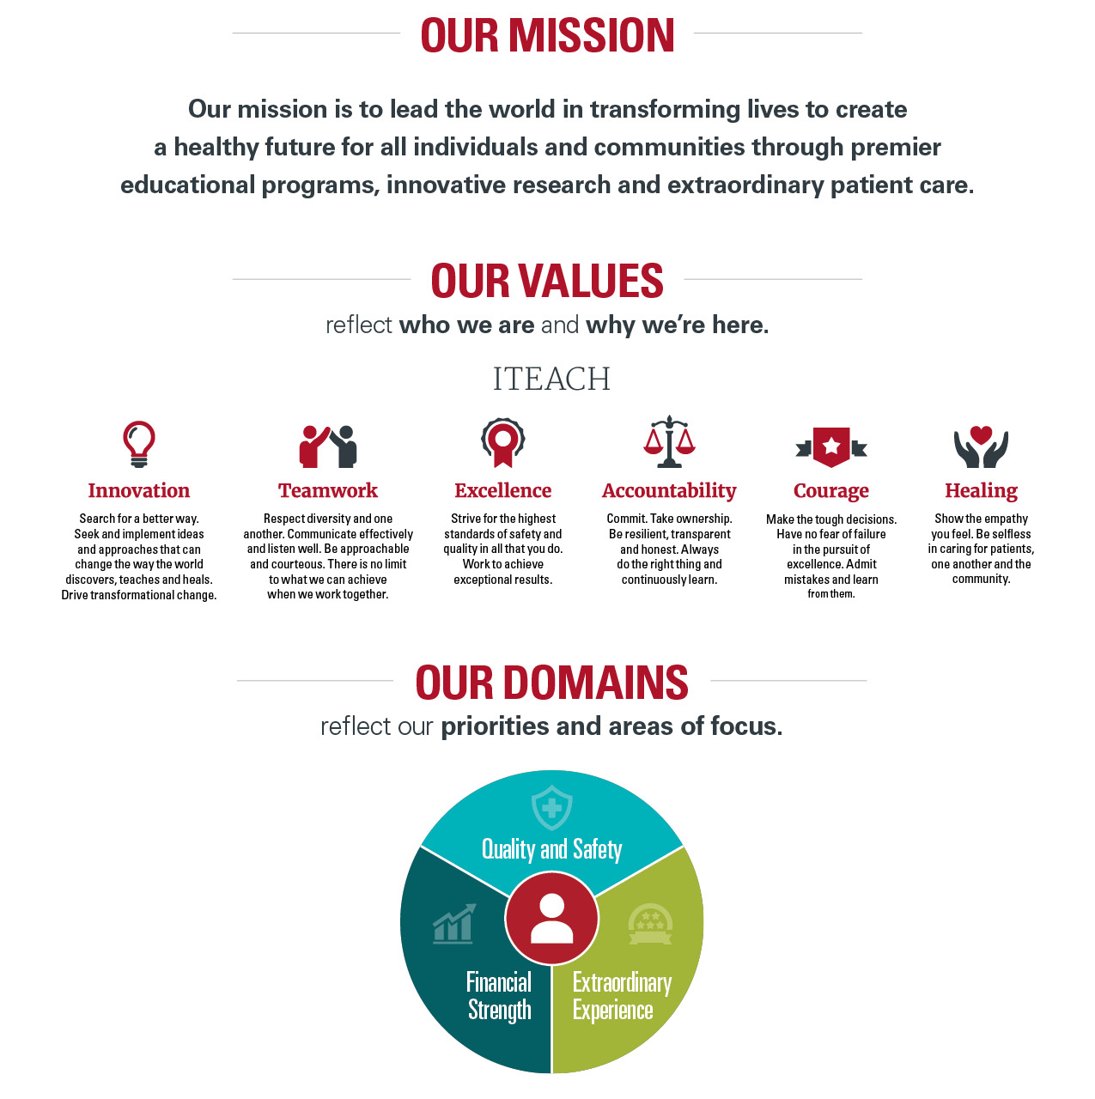

Slide 5
