Slide 1
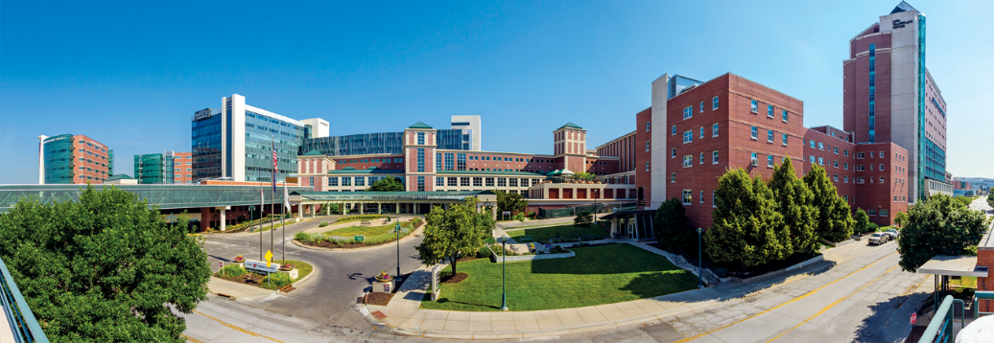
About Us
Nebraska Medicine
$2.5 billion academic health system
10,253 employees and more than 1,200 affiliated physicians
Primary clinical partner of University of Nebraska Medical Center
Two hospitals, anchored by tertiary/quaternary academic medical center
More than 70 specialty and primary care clinics, with 50 specialties and subspecialties
809 licensed inpatient beds in Omaha and Bellevue
Nebraska Medical Center: 718 licensed beds
Bellevue Medical Center: 91 licensed beds
In fiscal year 2024:
31,147 discharges
842,310 in-person primary and specialty patient visits
91,269 telehealth visits
97,800 emergency department visits
Fred & Pamela Buffett Cancer Center – Kearney opens in December 2024
Planning underway for Project Health, including a state-of-the-art academic medical center
Notes:
This reflects FY24
UPDATED Sept. 2024

Slide 2
About Us
Services and Awards:
International reputation in oncology, solid organ and bone marrow transplant and infectious disease treatment, research and education.
Regional leader in cardiovascular and neurosciences.
American College of Surgeons (ACS) verified Level 1 Trauma Center admitting pediatric and adult patients 24/7.
Named Best Hospital in Nebraska for 13 consecutive years by U.S. News & World Report.
Nebraska Medical Center named one of the nation's best hospitals by Newsweek for the past four years.
Bellevue Medical Center earned the Patient Safety Excellence Award from Healthgrades for three consecutive years.
National Consumer Loyalty Award winner from NRC Health for 15 consecutive years.
Named to Forbes list of Best-in-State Employers for six consecutive years.
Magnet Recognition from the American Nurses Credentialing Center since 2008.
Nebraska’s Safest Companies Award from the National Safety Council for 17 consecutive years.
HIMMS Analytics Stage 7 designation for inpatient and outpatient primary care is the highest certification for electronic medical record adoption.
Notes:
UPDATED SEPT. 2024
*US News, Newsweek and Forbes have been updated for FY24
US News best hospital in Nebraska- since 2011
Forbes Best in State – since 2019
Newsweek – verified on the best hospitals in USA list since 2021
BMC - Patient safety excellence awards from Healthgrades 2022 2022-24
2022 was 15 years for National Safety Council VERIFY FOR FY24 AND UPDATE THIS NOTE
No 2021 or 2022 Becker’s 100 great hospital awards held, was last awarded in 2019 [DELETED FOR FY24]
2021 was 13 years for NRC Consumer Loyalty award (formerly called consumer choice award)
HIMMS 7 valid through summer 2025

Slide 3
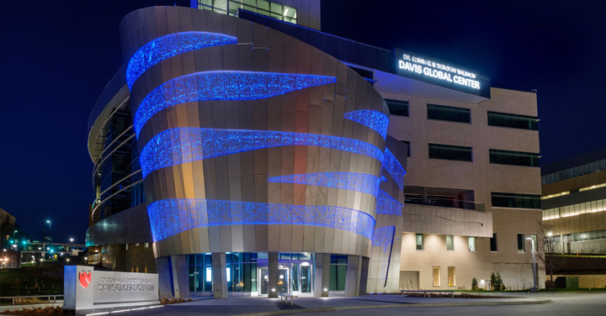
Partnership with the
University of Nebraska Medical Center
Five statewide campuses
4,703 students
6,334 employees
$1B operating budget
$222.3M in sponsored awards
$171.6M in research grants
UNMC ranks as one of the country’s top medical and pharmacy schools
US News & World Report 2024
UNMC and Nebraska Medicine have a combined annual impact of $5.9B on Nebraska’s economy
Notes:
UPDATED SEPT. 2024

Slide 4
Notes:
Placemat updated FY24

Slide 5
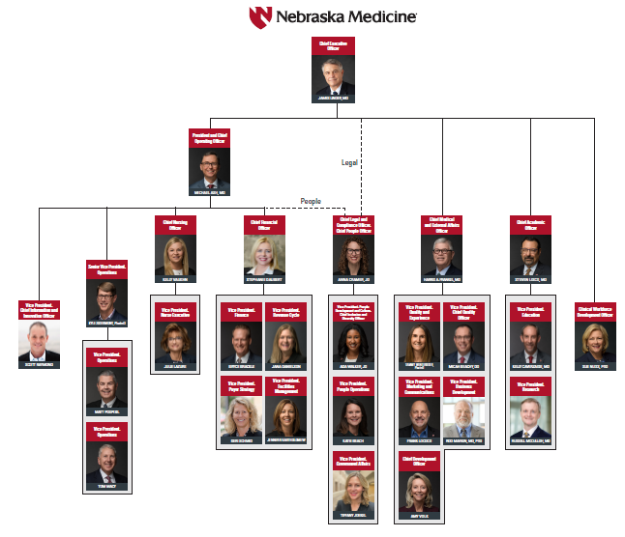
Notes:
Org chart is updated FY24

