Slide 1
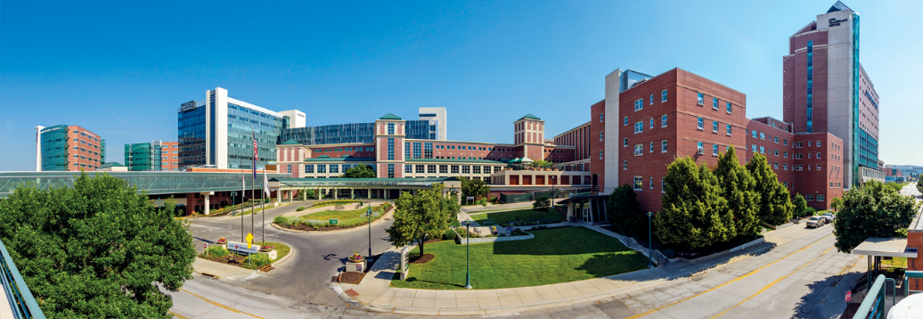
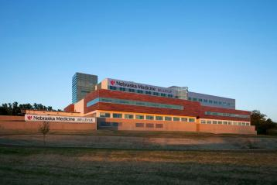
About Us
Nebraska Medicine
$2.5 billion academic health system
10,253 employees and more than 1,400 affiliated physicians
Primary clinical partner of University of Nebraska Medical Center
Two hospitals, anchored by tertiary/quaternary academic medical center
809 licensed inpatient beds in Omaha and Bellevue
  Nebraska Medical Center: 718 licensed beds
  Bellevue Medical Center: 91 licensed beds
Notes:
This reflects FY25
UPDATED Sept. 2025

Slide 2

About Us
Nebraska Medicine
More than 70 specialty and primary care clinics, with 50 specialties and subspecialties
Clinical locations in:
  Omaha
  Bellevue
  Grand Island
  Kearney
In fiscal year 2025:
  32,075 discharges
  997,447 in-person primary and specialty patient visits
  101,000 telehealth visits
  100,513 emergency department visits
Planning underway for Project Health, including a state-of-the-art academic medical center
  LaVista
  Papillion
  Plattsmouth
Notes:
This reflects FY25
UPDATED Sept. 2025

Slide 3
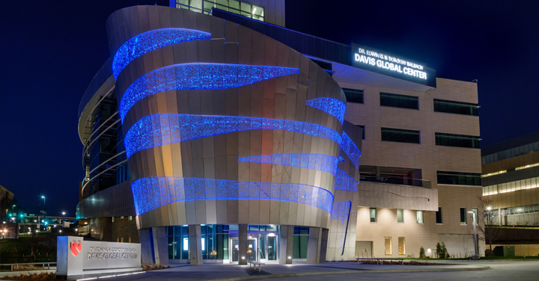
Partnership with the
University of Nebraska Medical Center
Five statewide campuses
4,818 students
6,498 employees
$1B operating budget
$222.9M in sponsored awards
$170.8M in research grants
UNMC ranks as one of the country’s top medical and pharmacy schools
US News & World Report 2024
UNMC and Nebraska Medicine have a combined annual impact of $7.1B on Nebraska’s economy
Notes:
UPDATED SEPT. 2024

Slide 4
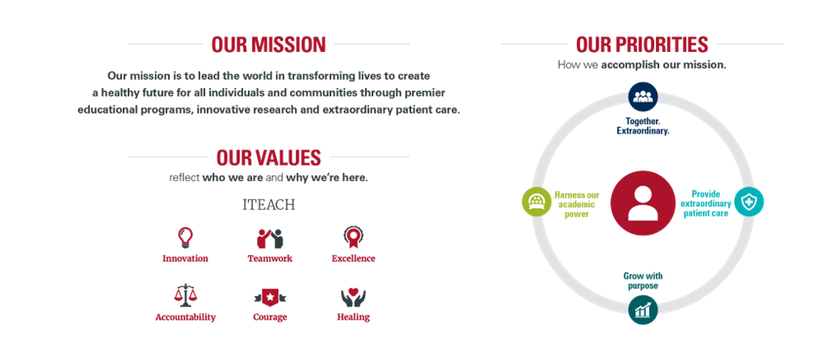
Notes:
Placemat updated FY24

Slide 5
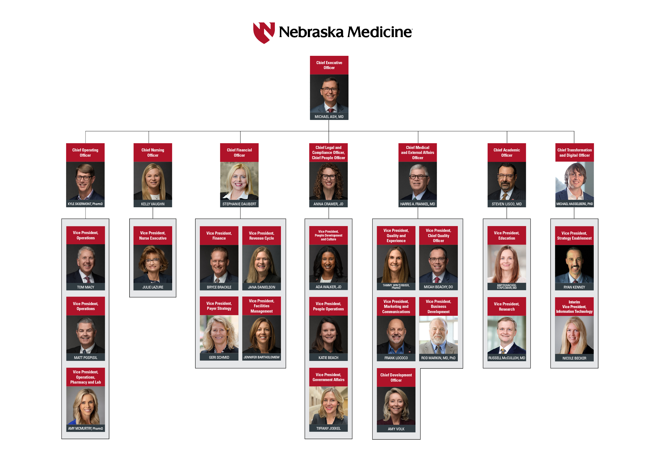
Notes:
Org chart is updated FY24

Slide 6
About Us
Services and Awards:
International reputation in oncology, solid organ and bone marrow transplant and infectious disease treatment, research and education.
Regional leader in cardiovascular and neurosciences.
American College of Surgeons (ACS) verified Level 1 Trauma Center admitting pediatric and adult patients 24/7.
Named Best Hospital in Nebraska for 14 consecutive years by U.S. News & World Report.
Nebraska Medical Center named one of the World’s Best Specialized Hospitals by Newsweek
National Consumer Loyalty Award winner from NRC Health.
Named to Forbes list of Best-in-State Employers for seven consecutive years.
Magnet Recognition from the American Nurses Credentialing Center since 2008.
Nebraska’s Safest Companies Award from the National Safety Council for 18 consecutive years.
HIMMS Analytics Stage 7 designation for inpatient and outpatient primary care is the highest certification for electronic medical record adoption.
Notes:
UPDATED SEPT. 2024
*US News, Newsweek and Forbes have been updated for FY25
US News best hospital in Nebraska- since 2011
Forbes Best in State – since 2019
Newsweek – verified on the best hospitals in USA list since 2021
BMC - Patient safety excellence awards from Healthgrades 2022 2022-24
2022 was 15 years for National Safety Council VERIFY FOR FY24 AND UPDATE THIS NOTE
No 2021 or 2022 Becker’s 100 great hospital awards held, was last awarded in 2019 [DELETED FOR FY24]
2021 was 13 years for NRC Consumer Loyalty award (formerly called consumer choice award)
HIMMS 7 valid through summer 2025

