Slide 1
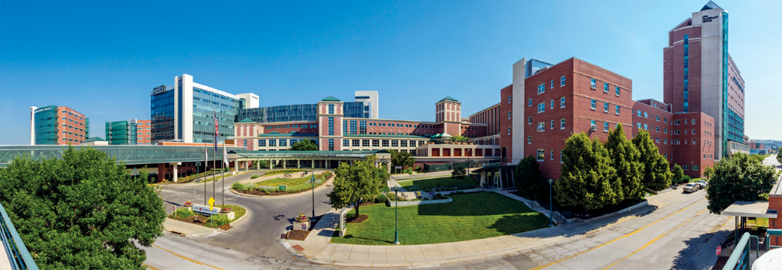
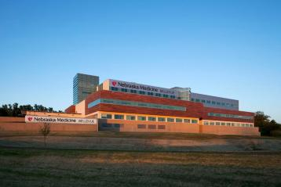
About Us
Nebraska Medicine
$3.6 billion academic health system
10,337 employees and nearly 1,400 affiliated physicians
Primary clinical partner of University of Nebraska Medical Center
Two hospitals, anchored by tertiary/quaternary academic medical center
809 licensed inpatient beds in Omaha and Bellevue
  Nebraska Medical Center: 718 licensed beds
  Bellevue Medical Center: 91 licensed beds
Notes:
This reflects FY26

Slide 2

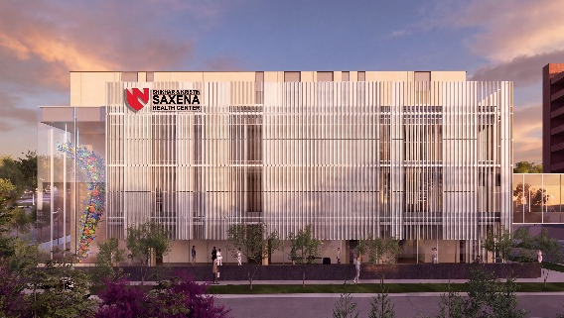
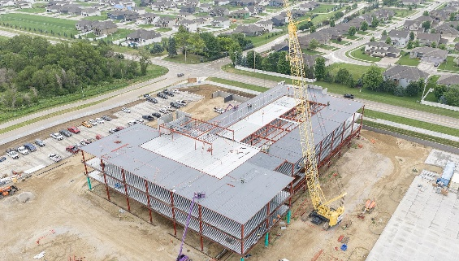
About Us Continued
Nebraska Medicine
Nearly 90 specialty and primary care clinics, with 50 specialties and subspecialties
Clinical locations in:
  Omaha
  Bellevue
  Grand Island
In fiscal year 2026:
  32,421discharges
  1,076,597 in-person primary and specialty patient visits
  109,000 telehealth visits
  101,636 emergency department visits
  Kearney
  LaVista
  Papillion
  Plattsmouth
Construction underway for Project Health, Saxena Health Center and Gretna Landing Health Center
Notes:
This reflects FY26

Slide 3
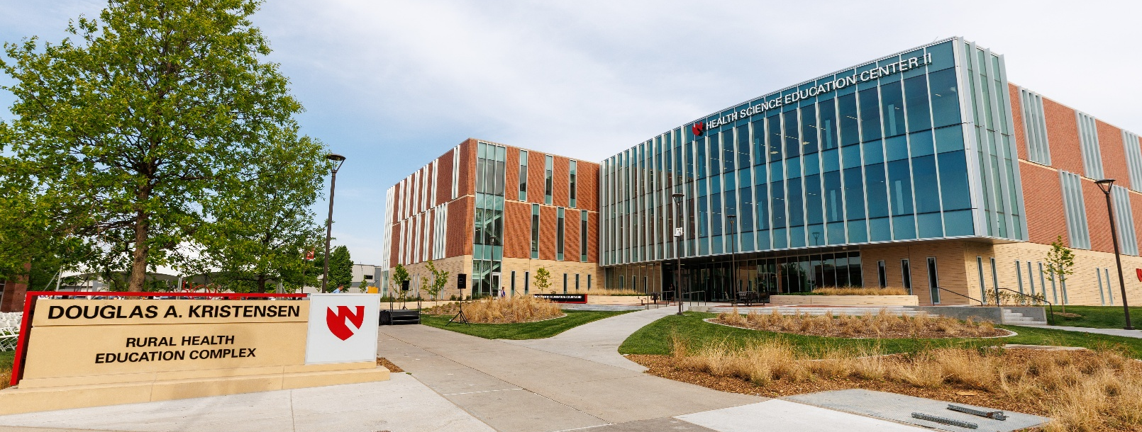
Partnership with the
University of Nebraska Medical Center
Five statewide campuses
4,847 students
6,508 employees
$1B operating budget
$290M in sponsored awards
$230M in research grants
To boost rural health workforce, UNMC educates physicians, pharmacists, nurses and more at its regional campus in Kearney
UNMC and Nebraska Medicine have a combined annual impact of $7.7B on Nebraska’s economy

Slide 4
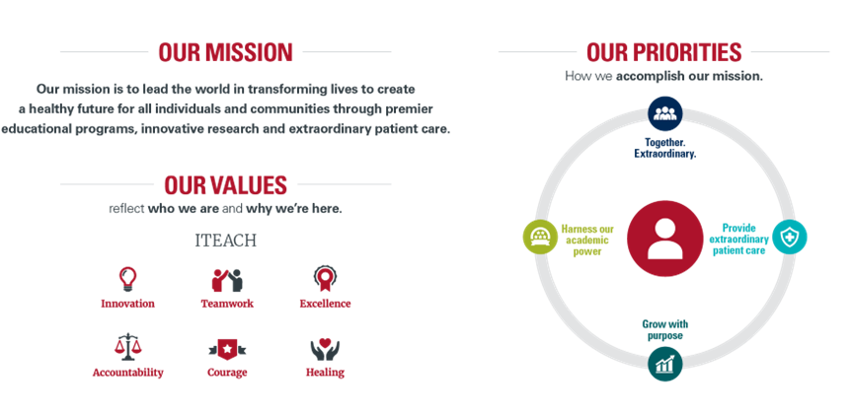
Nebraska Medicine mission, values, and priorities

Slide 5
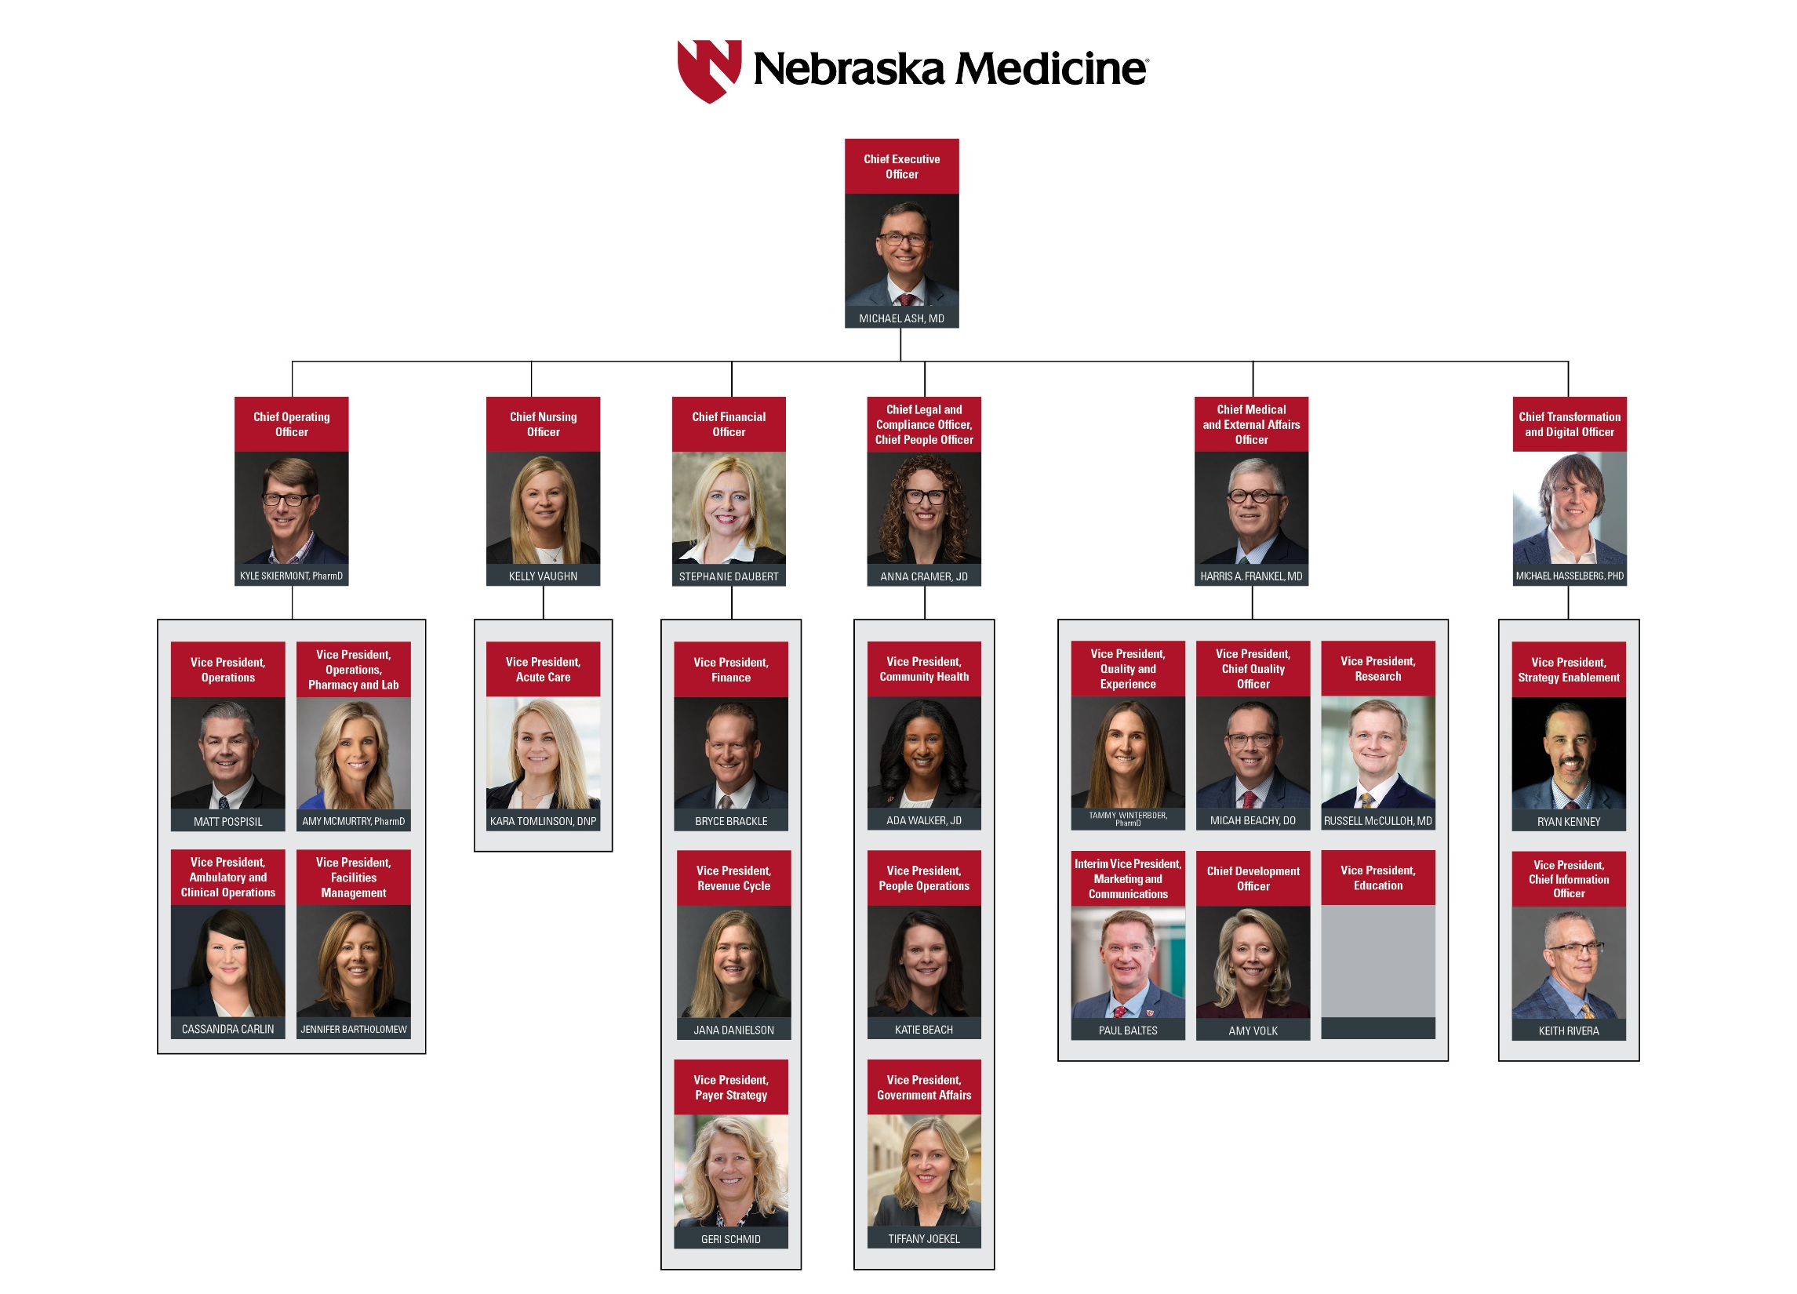
Nebraska Medicine leadership organization chart
Notes:
Org chart as of Sept. 2026
The Nebraska Medicine leadership organization chart with images of the leaders and their titles.

Slide 6
About our services and awards
Recognitions
Services and Awards:
International reputation in oncology, solid organ and bone marrow transplant and infectious disease treatment, research and education
Regional leader in cardiovascular and neurosciences
American College of Surgeons (ACS) verified Level 1 Trauma Center admitting pediatric and adult patients 24/7
Named Best Hospital in Nebraska for 15 consecutive years by U.S. News & World Report
The Fred & Pamela Buffett Cancer Center is the only National Cancer Institute-designated cancer center in Nebraska
Nebraska Medical Center named one of the World’s Best Specialized Hospitals by Newsweek
Magnet Recognition from the American Nurses Credentialing Center since 2008
Nebraska’s Safest Companies Award from the National Safety Council for 19 consecutive years
Notes:
UPDATED SEPT. 2026

